Slide 1
Descriptive Statistics: Numerical Measures

Slide 2
Some Key Concepts
Sample statistics
Numerical measures computed for data from a sample
Population parameters
Numerical measures computed for data from a population
Point estimator
A sample statistics in statistical inference.

Slide 3
Measures of Location
Mean
Mean (average)
Weighted mean
Geometric mean
Median
Mode (unimodal, bi-modal, multi-modal)
Percentiles
Quartiles

Slide 4
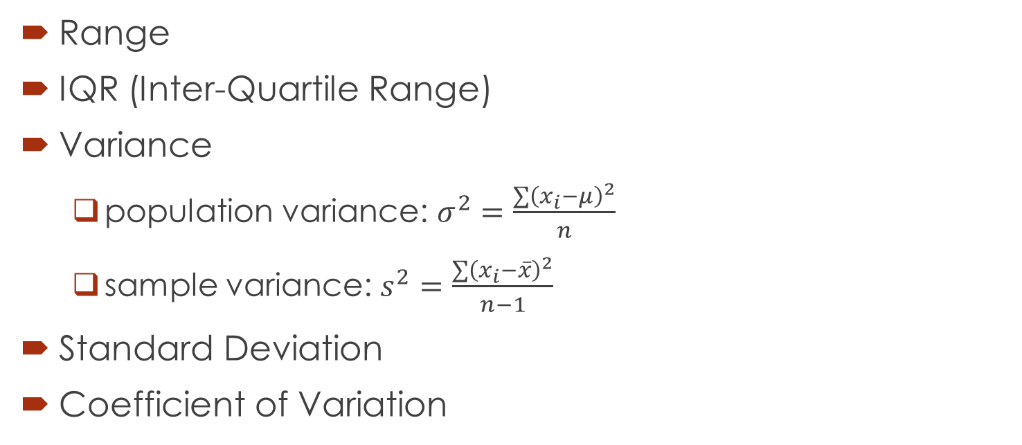
Measures of Variability
Range
IQR (Inter-Quartile Range)
Variance
population variance: $σ^{2}=\frac{\sum{{\left(x_{i}−μ\right)}^{2}}}{n}$
sample variance: $s^{2}=\frac{\sum{{\left(x_{i}−\overline{x}\right)}^{2}}}{n−1}$
Standard Deviation
Coefficient of Variation

Slide 5
Measures of Distribution Shape, Relative Location, and Detecting Outliers
Skewness*
Z-score/z-value
Chebyshev’s Theorem
Empirical Rule
Detecting Outliers
Beyond 3-sigma
1.5 IQR below Q1 or 1.5 IQR above Q3

Slide 6
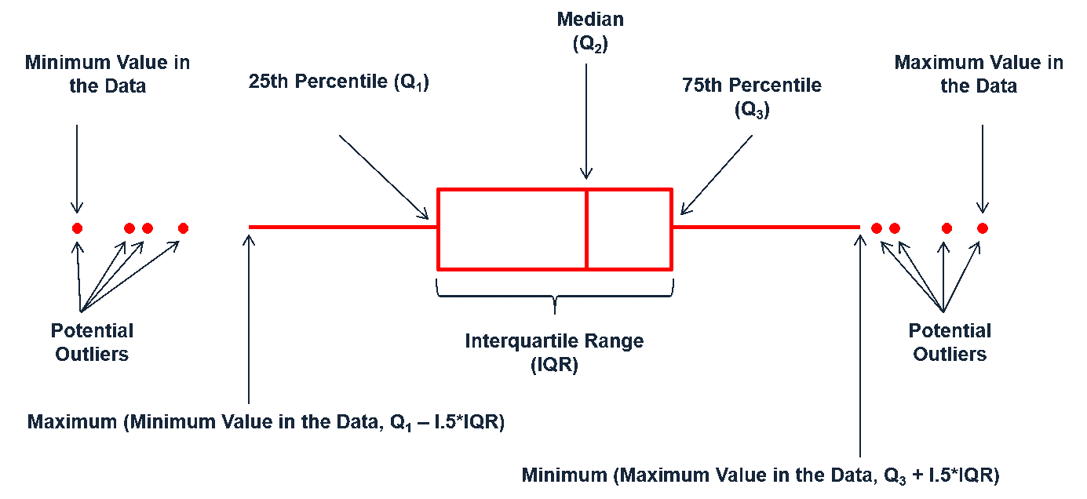
Five-Number Summaries and Box Plots
Smallest value
1st quartile (Q1)
Median (Q2)
3rd quartile (Q3)
Largest value

Slide 7
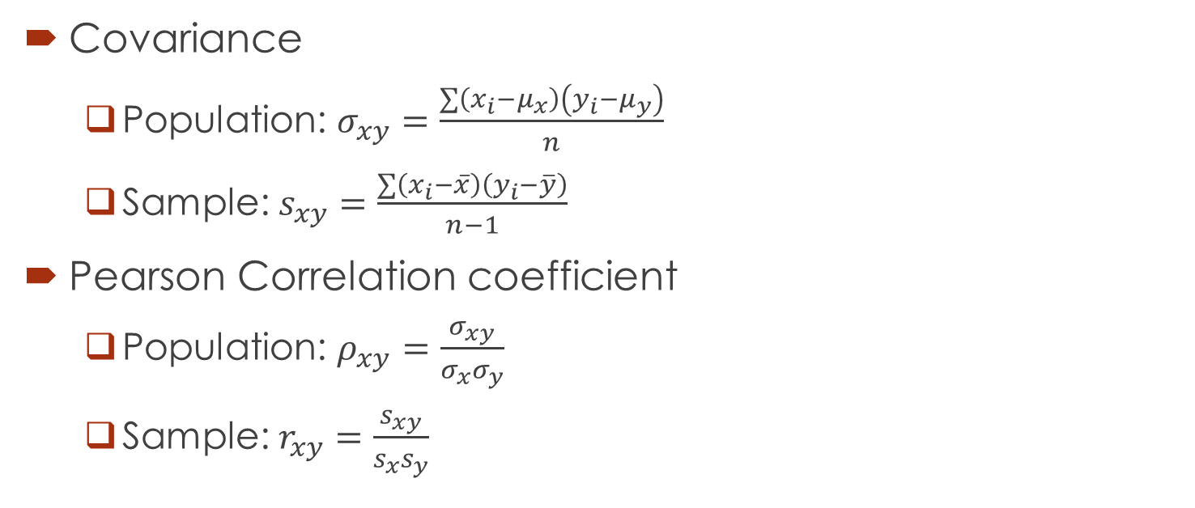
Measures of Association Between Two Variables
Covariance
Population: $σ_{xy}=\frac{\sum{\left(x_{i}−μ_{x}\right)\left(y_{i}−μ_{y}\right)}}{n}$
Sample: $s_{xy}=\frac{\sum{\left(x_{i}−\overline{x}\right)\left(y_{i}−\overline{y}\right)}}{n−1}$
Pearson Correlation coefficient
Population: $ρ_{xy}=\frac{σ_{xy}}{σ_{x}σ_{y}}$
Sample: $r_{xy}=\frac{s_{xy}}{s_{x}s_{y}}$

